Slide 1
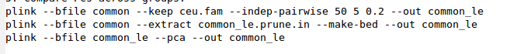
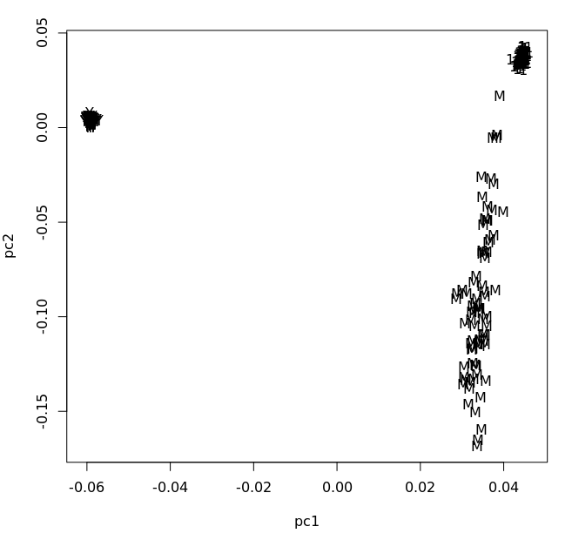

Slide 2
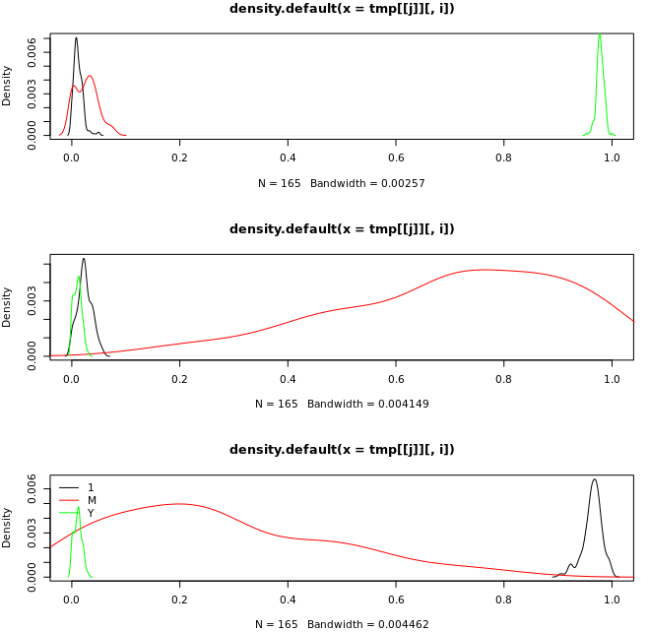
Admixture results

Slide 3
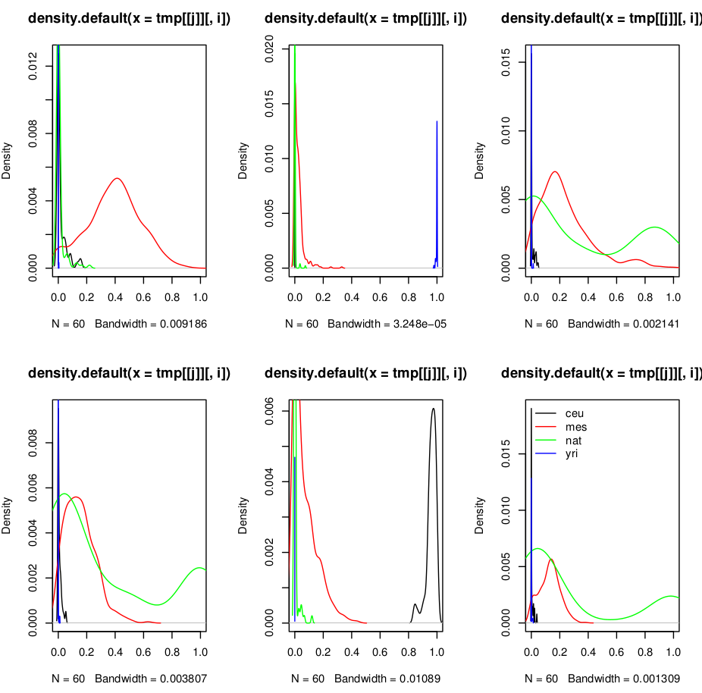
In other Mexican sample
Arbitrary k=6
What do things change for other values of k?

Slide 4

GWAS & Polygenic Scores 2016 Summer Workshop CEDUA El Colegio de Mexico, A. C.
Ben Domingue

Slide 5
Goals

Slide 6
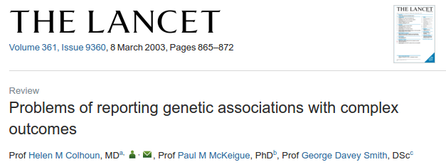
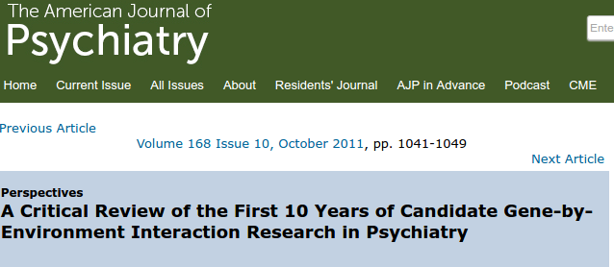
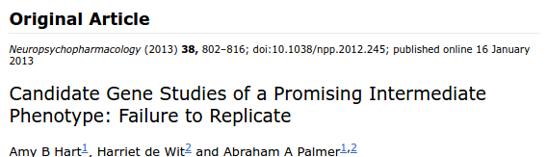
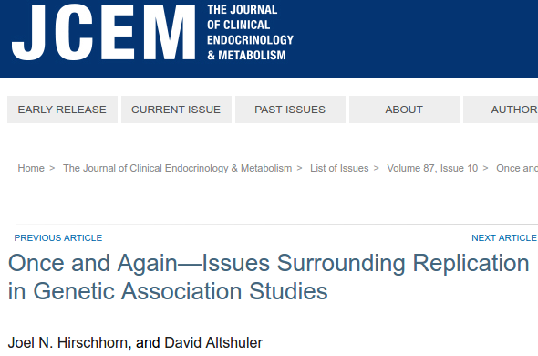
How do we link phenotypic variation to genetic variation?
First idea: candidate genes
A priori biological reason to suspect relevance.

Slide 7
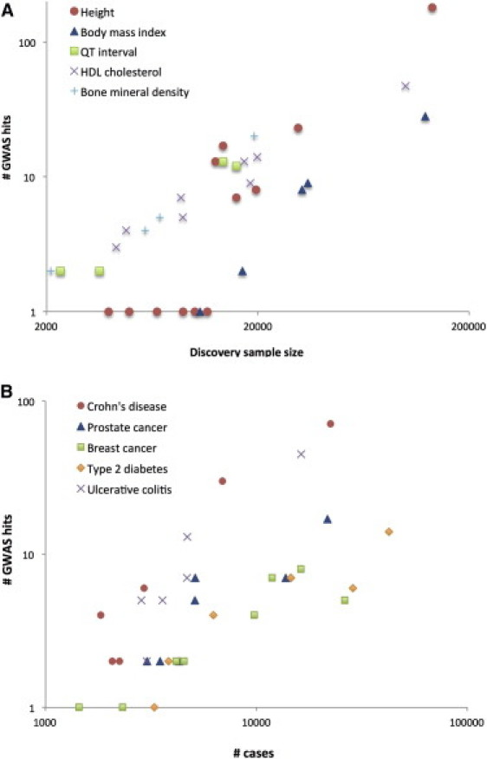
GWAS: basically data mining
Visscher et al., 2012
First, assemble LOTS of data.
Regress outcome on SNP + controls
Do this for every SNP
Look for SNPs that are sig after corrections for multiple testing (p<1e-8)

Slide 8
Theory of GWAS
GWAS relies on a certain set of assumptions (e.g., additivity).
Also has implications for “genetic architecture”.
We’ll come back to this later.

Slide 9
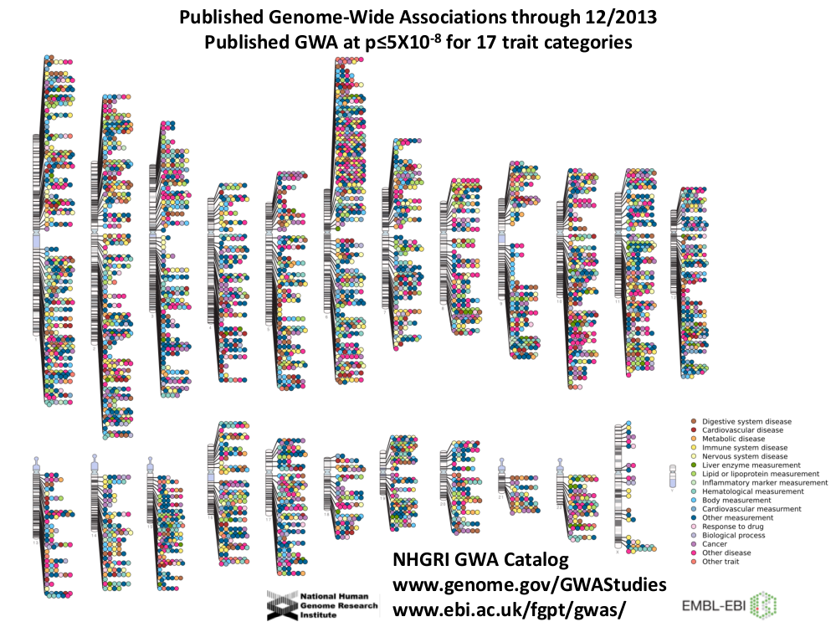

Slide 10
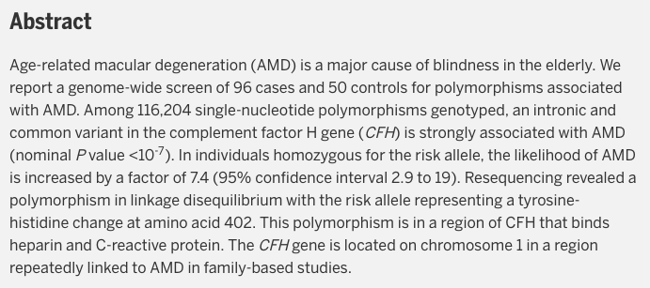
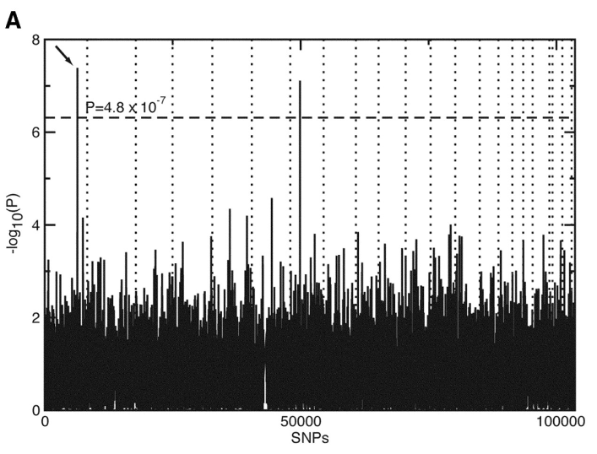
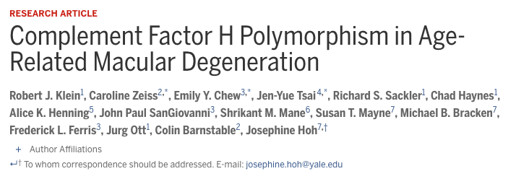
The first gwas

Slide 11
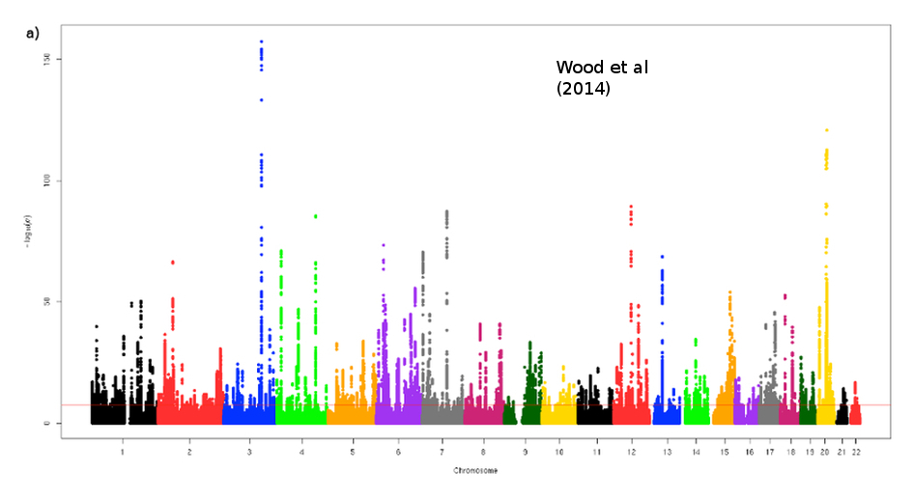
Height

Slide 12
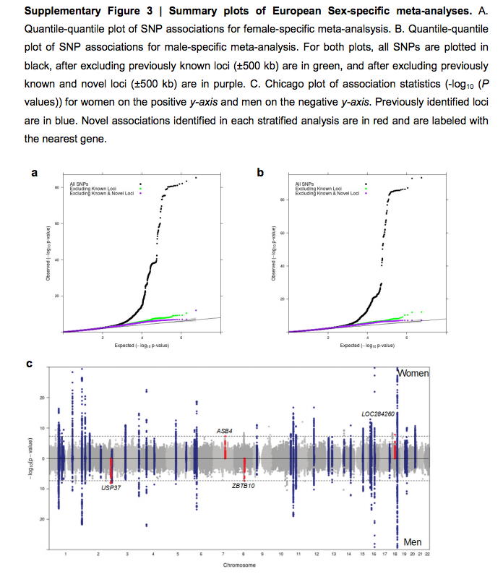
BMI (Locke et al 2015)

Slide 13
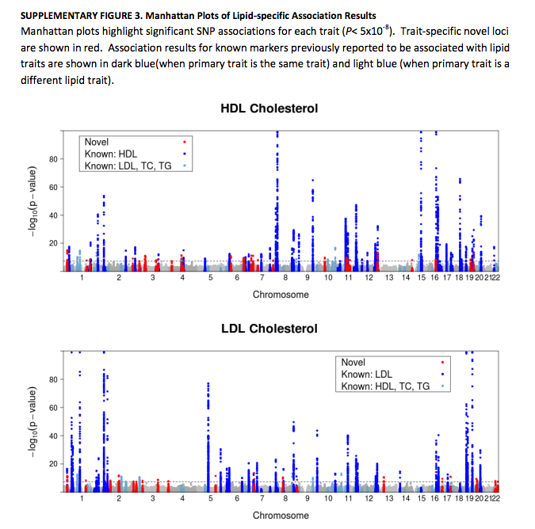
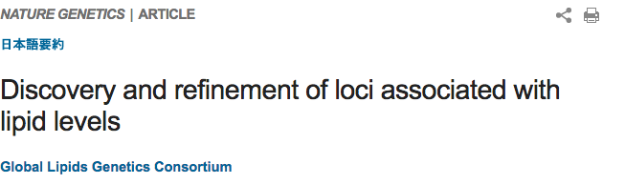

Slide 14
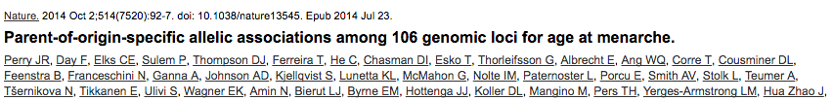
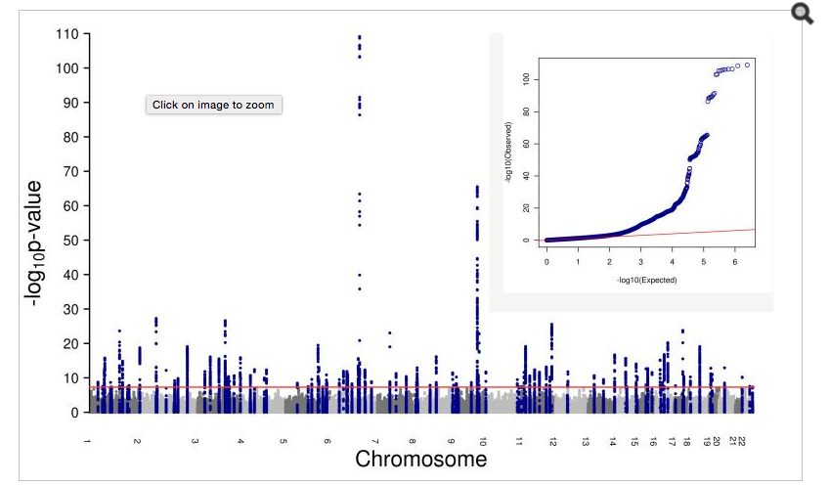

Slide 15
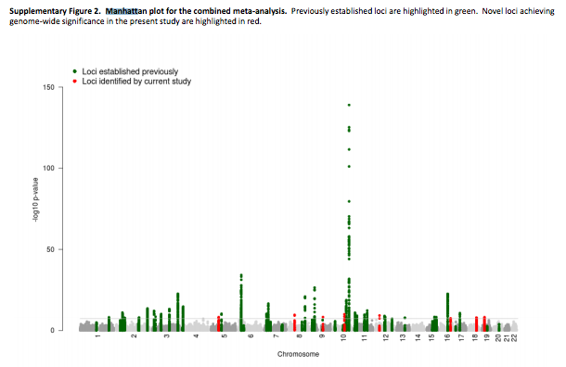
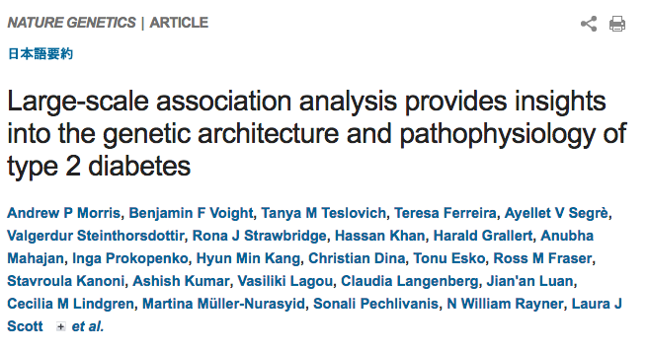

Slide 16
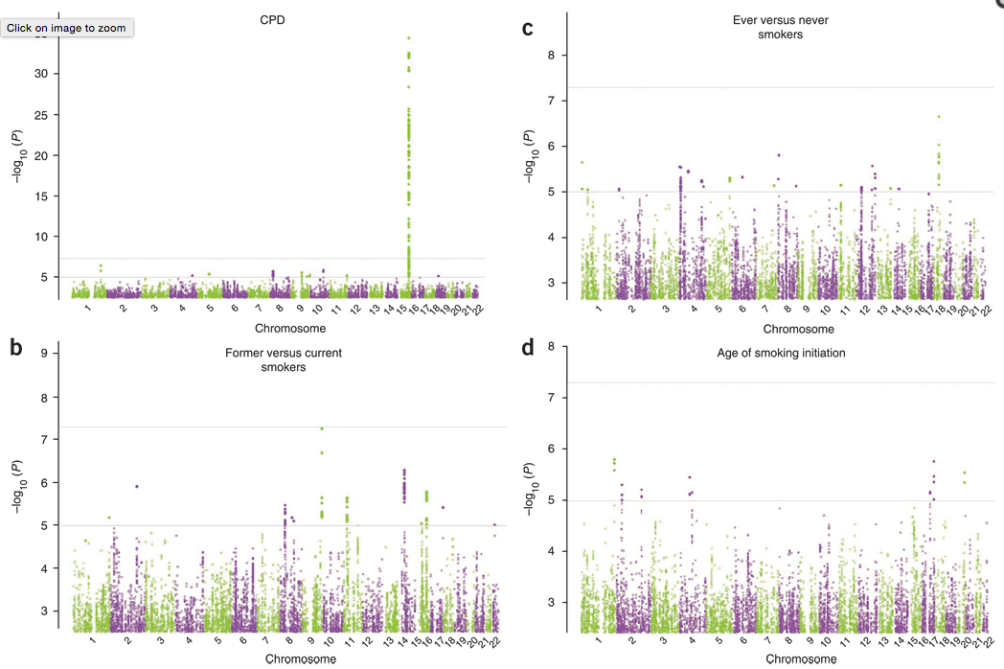
Smoking
Smoking

Slide 17
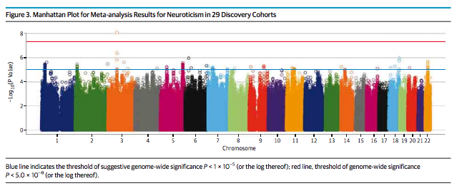
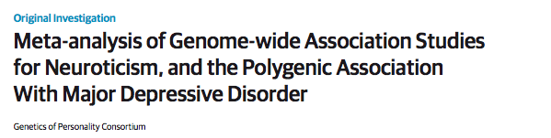

Slide 18
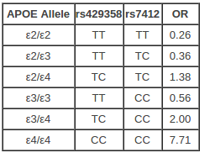
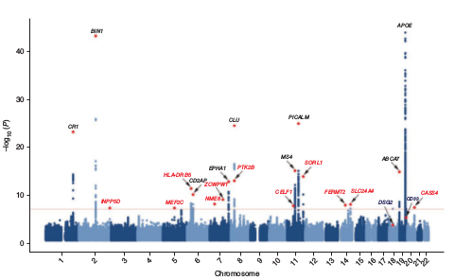
Alzheimer’s
Baseline risk:
9% M, 17% F
Source:
Genomes Unzipped
Lambert et al. 2013

Slide 19
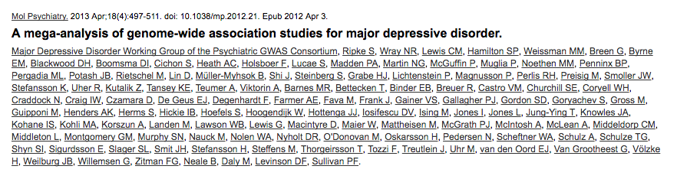
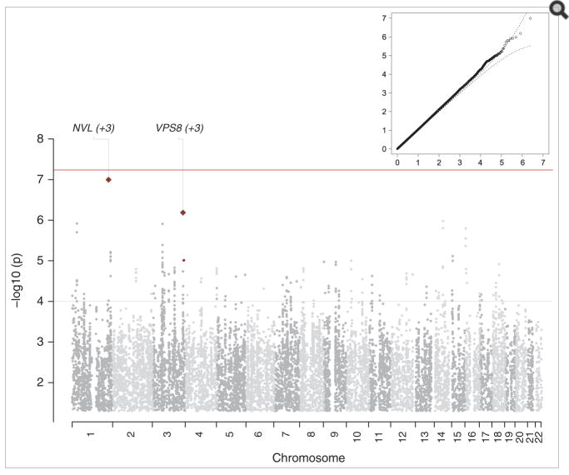

Slide 20
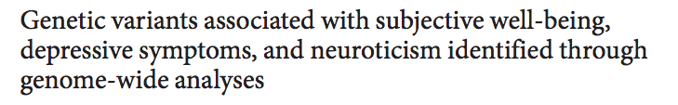
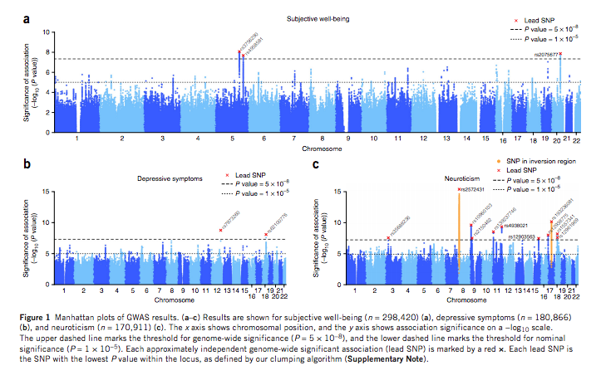

Slide 21
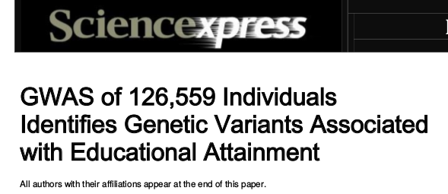
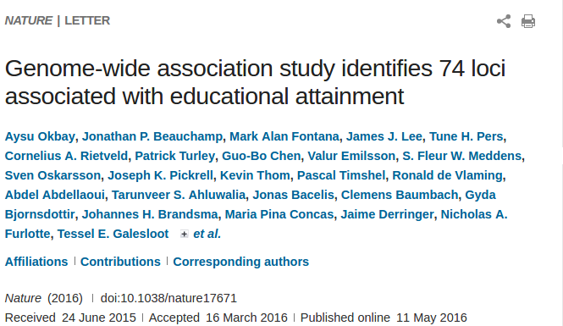
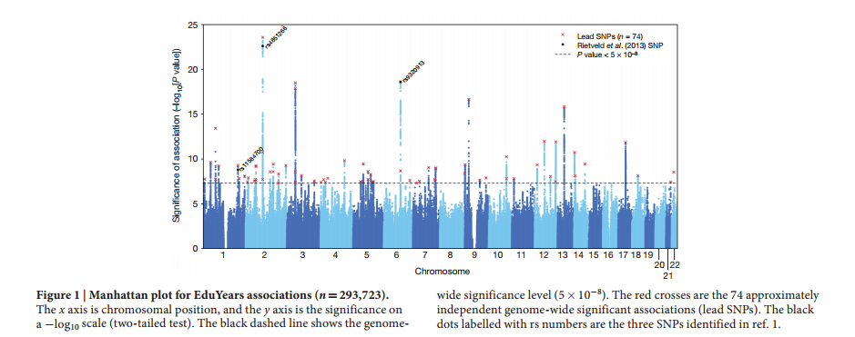
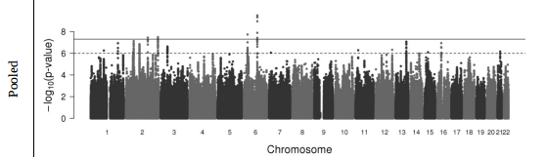
NEW!

Slide 22
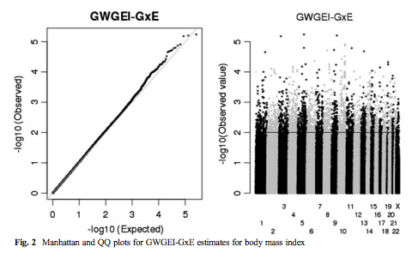
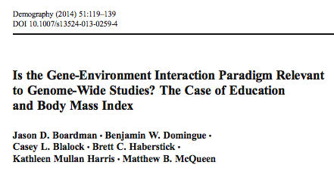
Why you shouldn’t do a gwas

Slide 23
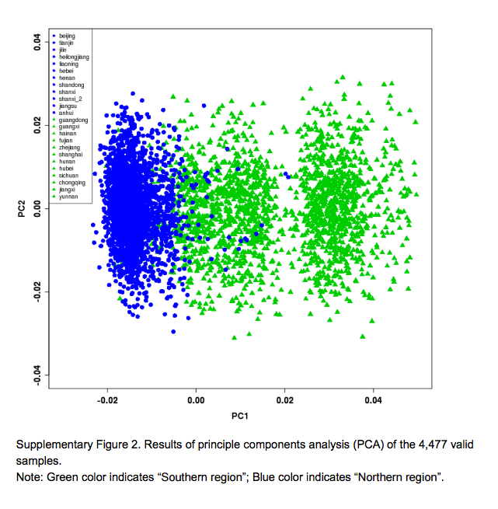
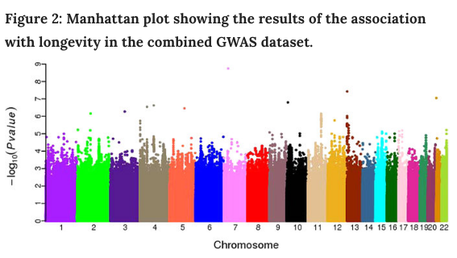
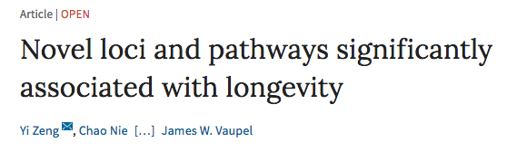
GWAS on non-European samples

Slide 24
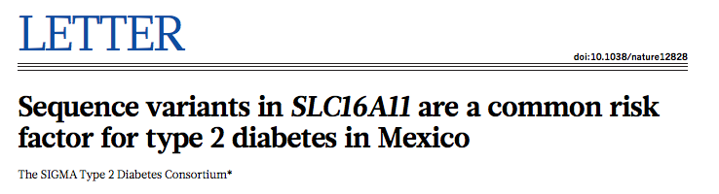
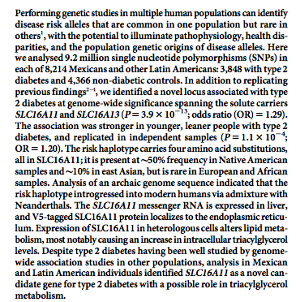

Slide 25
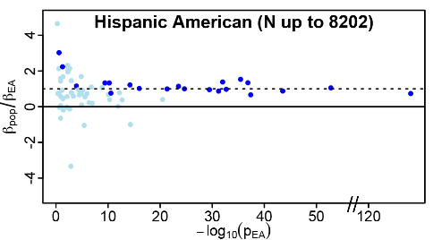
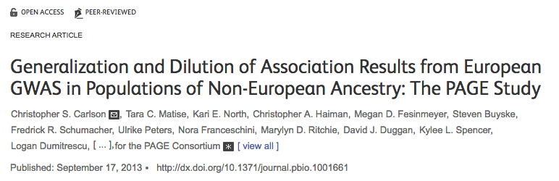
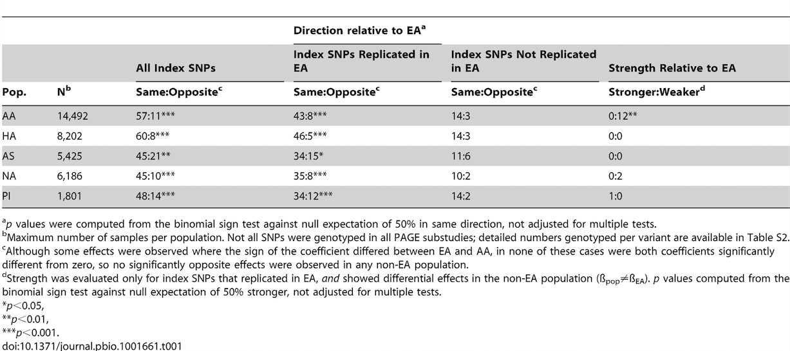

Slide 26
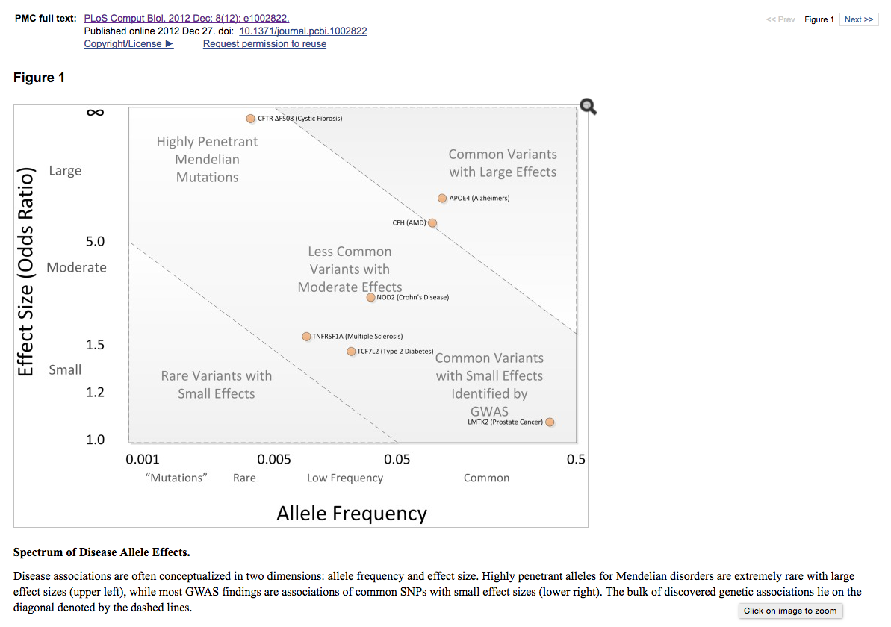
On genetic architecture

Slide 27
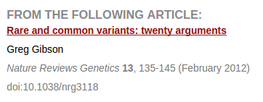
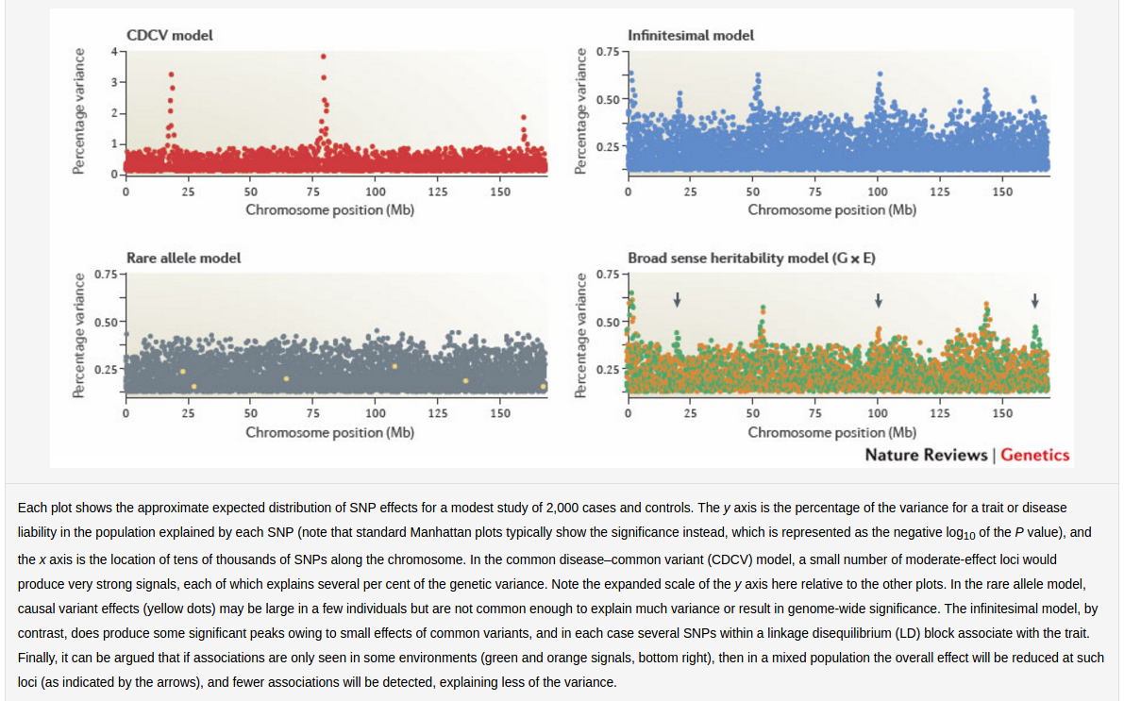

Slide 28
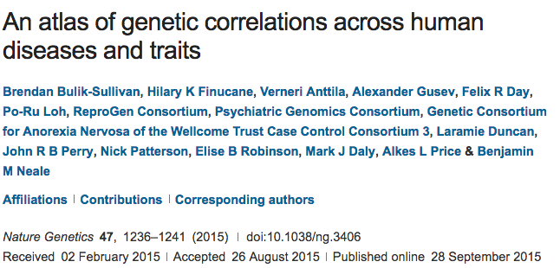
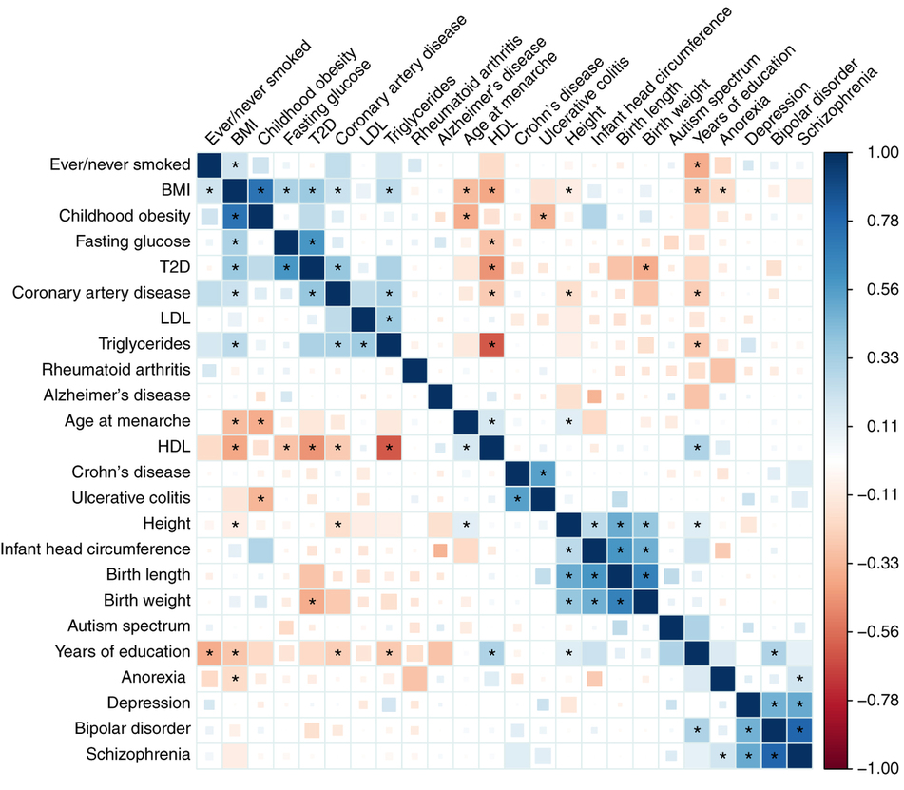
Overlapping genetic architectures

Slide 29
Lab 1

Slide 30
What are we going to do with GWAS data?
Going to demonstrate a potential line of research related to educational attainment.
Other stories could be told about bmi/smoking
BMI:
Within-family: http://journals.plos.org/plosone/article?id=10.1371/journal.pone.0101596
Cohorts: http://asr.sagepub.com/content/80/4/705.short
Development: http://archpedi.jamanetwork.com/article.aspx?articleid=1171937&goback=.gde_4173543_member_121667167
Behavioral moderators:
Sugary drinks http://www.nejm.org/doi/full/10.1056/nejmoa1203039
Fried foods http://www.bmj.com/content/348/bmj.g1610
Exercise http://journals.plos.org/plosmedicine/article?id=10.1371/journal.pmed.1000332
Smoking:
Cohorts: http://link.springer.com/article/10.1007/s10519-015-9731-9
Development: http://archpsyc.jamanetwork.com/article.aspx?articleid=1672838&resultclick=3
Environmental moderators: http://www.nature.com/tp/journal/v3/n8/abs/tp201363a.html

Slide 31
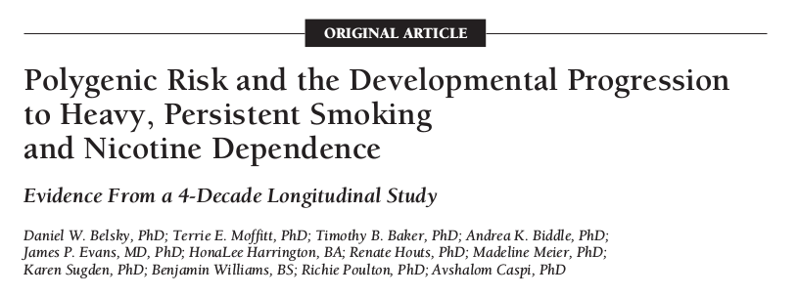


Polygenic Scores (PGS)
Like a credit score
+
They are predictors of the type we are accustomed to.
Prediction >> Description
Going to turn to issues related to PGS for EA
Question 1: how robust is their prediction?

Slide 32

Predict out of sample
Important point given the failures of candidate gene studies!

Slide 33


Predicts net of mom’s education

Slide 34


Predicts within families

Slide 35


Predicts within families.

Slide 36


Predicts academic performance

Slide 37

Robust prediction, now what?
Possibilities
Developmental pathways & broader outcomes
Association and moderation by schools
Dynamics (as function of birth cohort)
And nothing is necessarily constant over time!

Slide 38

One obvious pathway from genetics to educational attainment is cognition.

Slide 39


But there are other candidates.

Slide 40

Preliminary Evidence regarding developmental pathways from Add Health
Strong associations with GPA and verbal ability.
Appearance!
No connection to # of friends.
Associated with smoking, but not other potential behavioral problems.
Not associated with personality factors.

Slide 41

Clustering of PGS into schools
What is effect of the clustering we do observe?
Genetics of EA student’s peers are more predictive than their own.

Slide 42

How much variation is there in the PGS effect between schools?

Slide 43

In Add Health, PGS for EA associated with various SES measures
Self-identified SES, mobility, and financial problems.
Some evidence this is true even conditioning on EA.
Associations are contingent upon social norms. These are not constant!
But first, let’s talk schools.

Slide 44
Will leave things there for the moment, but work on polygenic scores is very hot right now.

Slide 45
Now let’s talk about construction.

Slide 46
PGS types
Top hits: only SNPs that reach some (stringent) level of statistical significance (1e-8)
Genome-wide: all SNPs or all below some nominal level of significance (0.5)

Slide 47
Hopefully you have some interesting ideas for how to use a PGS (or at the very least have been inspired to think about how one might use them).
But where do they come from?

Slide 48

Constructed by “others”
But you are limited to what they have available (can’t use new or updated results).

Slide 49
What about making your own?
Hopefully you’ll leave today equipped to do so!

Slide 50
Some things to be mindful of before we get started.
Additivity
Strand Ambiguity
Weights
LD considerations

Slide 51

Additive Model of Genetic effects
In general, GWAS attempt to identify additive (as opposed to dominant or recessive) genetic effects.

Slide 52

Ambiguous strands

Slide 53

GWAS Results
Empirical Data
1 rs3934834 0 1005806 A G

Slide 54

Strand issues
Paired bases: A-T, C-G
Fwd strand A/C implies reverse strand T/G
Suppose GWAS identifies A as risk allele. [note: they may not give you other allele.]
Your data:
What base in your data will be equated to the A in GWAS results?

Slide 55
Strand issues
In “top hits” scores, you can try to determine what is going on via comparison of allele frequencies to some kind of reference.
Authoritative info hard to come by (and needs to be population specific).
Not going to work if allele frequencies aren’t easily distinguished.
Very nasty issue, but I have some workarounds.

Slide 56
Weights
Each SNP will be weighted by the magnitude of its effect.
For continuous traits, the estimated coefficient.
For dichotomous traits, log of the OR.
If you’re doing a top-hits score, then may not need to weight.

Slide 57

LD considerations
Too many variants in linkage with a certain causal variant could lead to overemphasis of that region in the PGS
Instead of LD pruning, LD clumping:
Select variants in LD blocks that are most highly associated with outcome.
LDpred:

Slide 58

Let’s make some scores
We are going to make scores using some of my homemade software:
https://github.com/ben-domingue/HeritHelper
Other options exist:

Slide 59

make_pgs()
Homebrewed function to create a pgs.
Available at https://github.com/ben-domingue/HeritHelper/blob/master/R/make_pgs.R

Slide 60
4 Step process
Remove ambig SNPs from the GWAS file.
Clumping
Remove ambig SNPs and those removed in step 2 from plink files.
Generate polygenic score
Step 3 is really messy.

